Slide 1
Team Traffic
Traffic Optimization Problem Application
Aaron Lyons, Adam Reichanadter, Alex Smith, Anthony Chavez, Joe Kurtz,
Brandon Wichman, Joshua Peter, Sam Clement, Soheil Sepahyar, Yuchen Wang
2/11/2020

Slide 2
Student Nominal Use Scenario

Slide 3
Users and Environment
Users
The main users will be students in the class
Environment
The environment for the users will likely be in a classroom or other educational room

Slide 4
Scenario Description
The student will log in through an email link received from the professor
On their turn, the student will select nodes from the network forming a path to get from their Origin to Destination in the quickest time possible
The student will hit End Turn button when finished with their turn
This cycle will repeat for all of the students until the session has ended

Slide 5
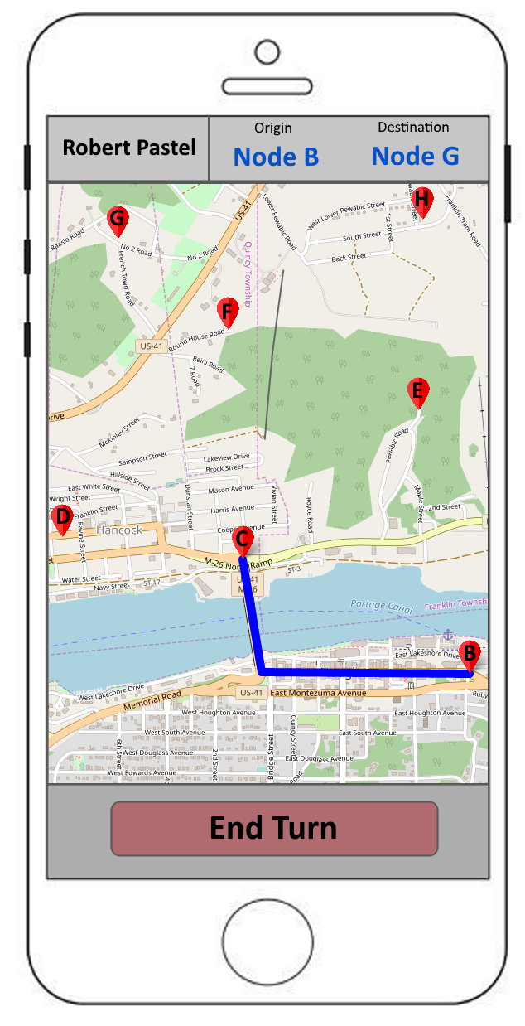
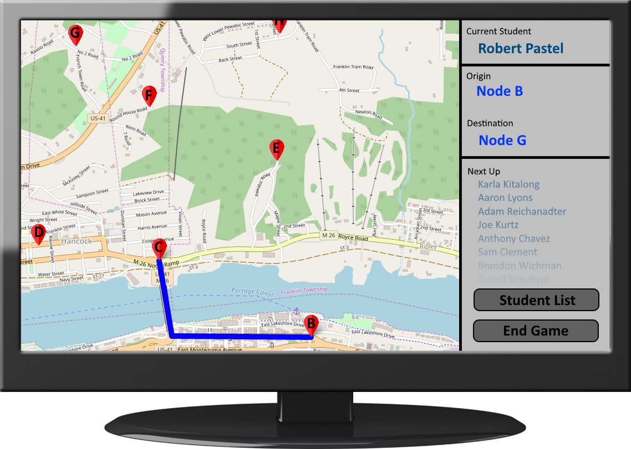

Slide 6
Professor Nominal Use Scenario

Slide 7
Users and Environment
Users
The main user will be the professor
Students may view the screen if it is on the projector
Environment
The environment that the users will be in will likely be a classroom or office

Slide 8
Scenario Description
Professor logs in
Begins a new game session
Invites students
Directs students to pick their routes
End game, saving it to the database

Slide 9
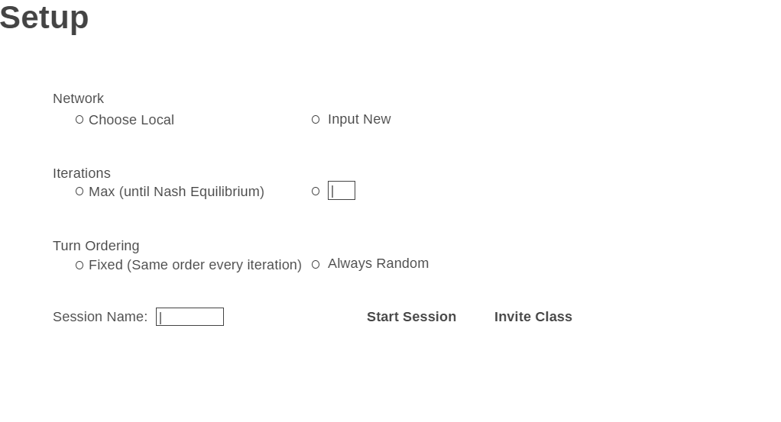

Slide 11
Your session has been saved

Slide 12
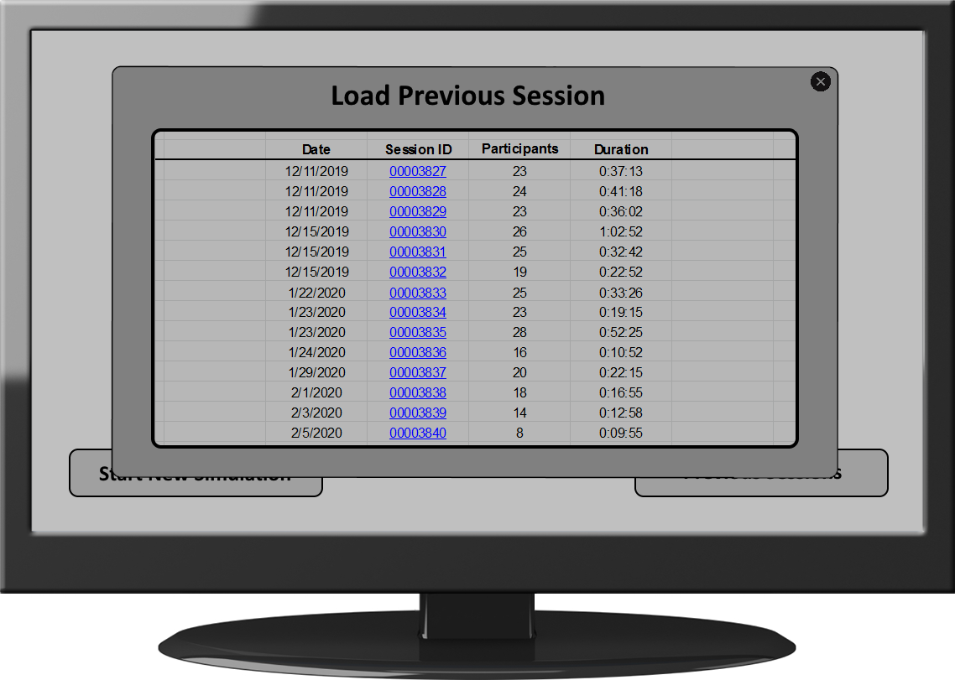

Slide 13
Usability Goals and Concerns
Goals
Have all relevant use information on a single page
Design application so that minimal instructional content is needed
Include a large map for instructor to teach with while including other necessary information
Concerns
The ease of selecting paths on a mobile phone
Where to display drive times and other technical data
Displaying different data to each student

Slide 14
Heuristic Evaluation
Compared Application - Google Maps live traffic
Heuristics Evaluated - Visibility of system status, match between system and the real world, user control and freedom, consistency and standards, help and documentation
Visibility - Automatic updates/refresh the map
Match Between System & World - Green/Yellow/Red indicates speed
User Control & Freedom - Easy and intuitive to use and navigate the app
Consistency & Standards - All features should have clear & obvious use
Help & Documentation - Necessary for efficient use of the app

Slide 15
Preliminary Instructional/Content Recommendations
Student Instructions
Wait for invitation from instructor and accept it
Login with Michigan Tech credentials
Wait for your turn to choose a route
When it is your turn, enter origin and destination points
Once path is set, choose “End Turn”, and notify instructor
Professor Instructions
Login with master credentials
Send web app invitations to students
Set up game session with desired network
Start the “game” session, and tell one student at a time to input their origin and destination points
Monitor the network
6) When the game is finished, choose the “End Game” option to review it later

Slide 16
Thank You; Any Questions?

